Slide 1
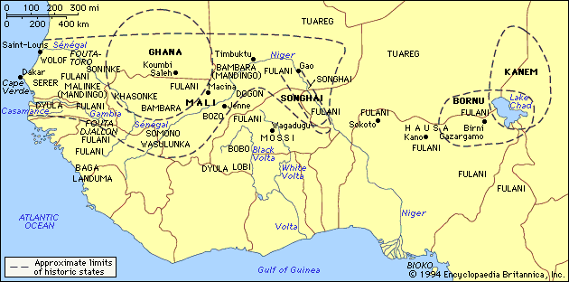
The Three Empires of West Africa
Ghana, Mali and Songhai
7.4.1, 7.4.3, 7.3.5

Slide 2
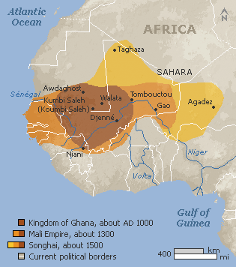

Ghana: Chapter 6, Section 1
Rise of Ghana
One of three great civilizations that arose along the Niger River
Ghana was located between salt and gold mines
Ghana’s power came from their use of iron weapons to conquer neighboring tribes and for farming along the Niger River
The Nok people from this region were the first to use iron to make farming tools and weapons for defense

Slide 3
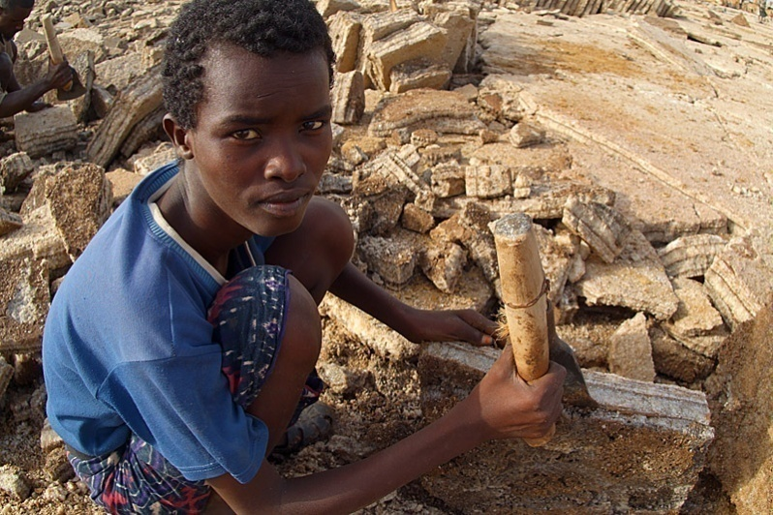
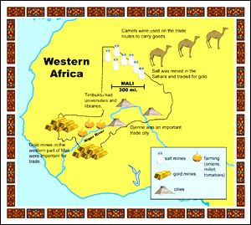
Salt merchants from North Africa crossed the Sahara Desert to trade with gold miners south of Ghana
Ghana taxed traders passing through their trade route
Salt is needed to preserve and flavor food, and to restore PH balance from sweating
Koumbi (Kumbi), was a trading center and a capital of Ghana. It became the wealthiest city in W. Africa

Slide 4
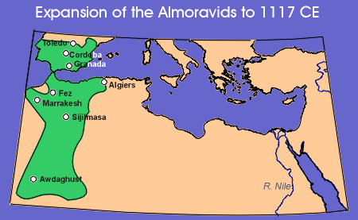
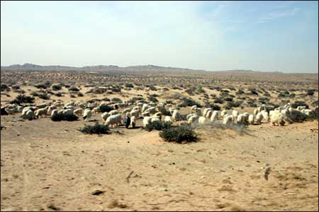
Decline of Ghana
Almoravids, a group of strict Muslims, believed it was their destiny to take over Ghana. They fought for 14 years, weakening Ghana
Overgrazing - Almoravids brought herding animals to Ghana. The herds ate the grass and left the ground exposed to sun, which made soil hard to farm
Internal Rebellion - Rebels weakened Ghana and it was eventually attacked by neighbors

Slide 5
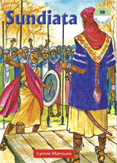
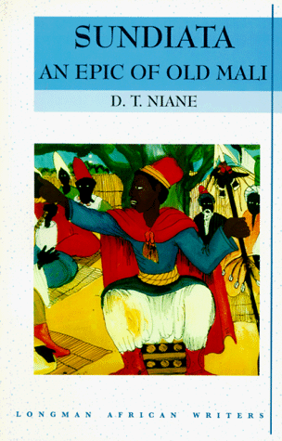
Mali: Chapter 6, section 2
Rise of Mali
Territory twice the size of Ghana, along the Niger River
King Sundiata conquered Ghana and led Mali to become a powerful trading empire

Slide 6
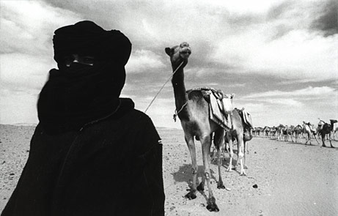
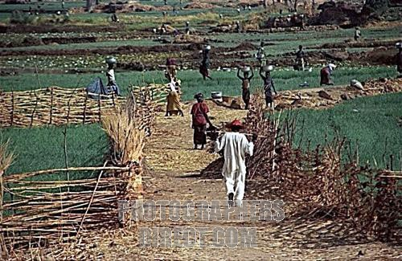
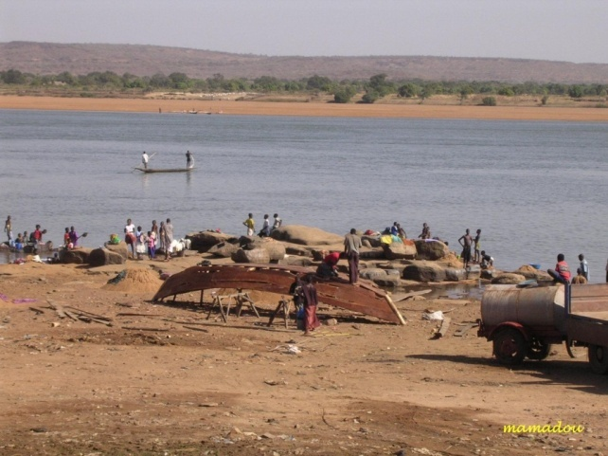
Sundiata & the Economy of Mali
Sundiata concentrated on agriculture, rice, onions, beans, cotton
Economy based on trade, that crossed the Sahara (sub-Saharan trade) with help of the Berbers
The Berbers - A group of northern African people that lead desert caravans through the Sahara
Mali discovered more gold mines and became the most powerful kingdom in Africa
The Niger River became a busy highway for all kinds of trade

Slide 7
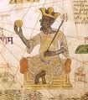
Mansa Musa’s Rule
Another of Mali’s greatest rulers during the empire’s height
Was a devout Muslim, but he tolerated other religions (allowing non-Muslims to keep their own religion)

Slide 8
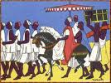
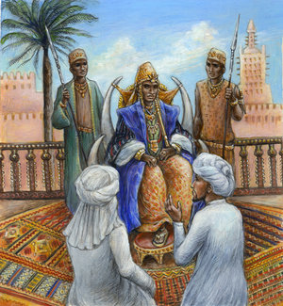
Mansa Musa’s Pilgrimage
Made an impressive pilgrimage to Mecca with 50,000 people. Slaves carrying gold staffs, 80 to 100 camels carrying 100 pounds of gold
In Cairo, Egypt he gave out so much gold that the local gold coin depressed for a decade
He became famous and introduced the world to the Mali Empire
Muslims scholars impressed by his wealth, were invited to be a part of his Empire

Slide 9
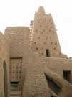
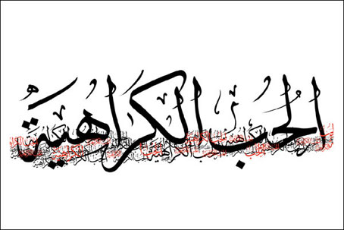
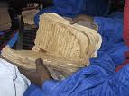
Islam Influences West Africa
Under Mansa Musa’s reign Muslim culture and education flourished
He hired architects to build mosques, he sent Muslim scholars to study in Morocco and he stressed the importance of learning Arabic to unify his empire
The city of Timbuktu became center for learning

Slide 10
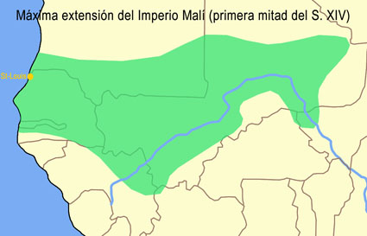
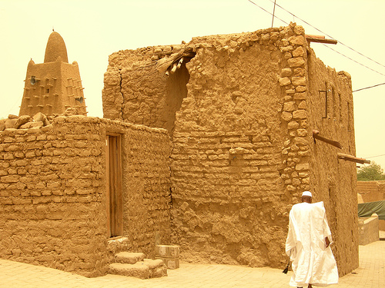
The Decline of Mali
After Mansa Musa’s death there was weak leadership
Invaders weakened empire and burned schools in Timbuktu
The empire had grown so large that it was difficult to control, slowly outer areas began to break away

Slide 11
Chapter 6, Section3
Birth of Songhai Empire
Rise of Songhai:
After Mansa Musa died, kings were unable to protect the territory
Songhai rises to power after attacking Mali from all sides

Slide 12

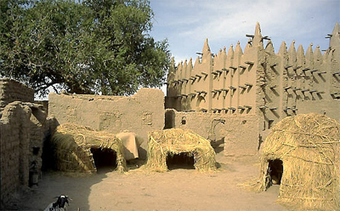
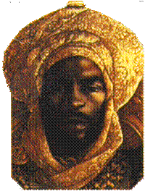
Sunni Ali’s Leadership of Songhai
Sunni Ali organized, strengthened and unified Songhai
He unified Songhai by encouraging people to work together, and he participated in both Muslim and local religions

Slide 13
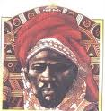
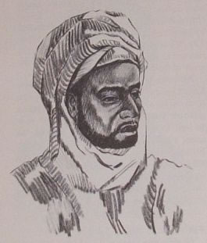
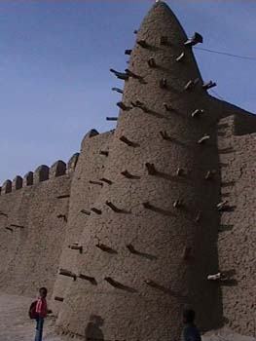
Askia the Great
Askia the Great rose to power. Songhai became great center for learning
Askia welcomed Muslims to trade by making similar laws
Songhai grew into the greatest trading empire in West Africa
Timbuktu and Djenne were centers of learning and trade

Slide 14
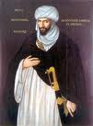
The Decline of Songhai
Morocco’s rulers captured Songhai’s salt mines; they also wanted the gold in West Africa
Songhai would stay around another 150 years, but not the same well-organized empire, instead it became a series of military camps

